Slide 1
Web Application Security at CSU
Greg Vogl, Identity & Access Management
Kelly Poto, User Awareness & Training
Cybersecurity & Privacy
Professional Development Institute, January 12, 2022
Notes:
The presentation will be recorded, and the recording and slides will be available in Teams after the presentation. Feel free to distribute to others at CSU.
Identity and Access Management (formerly ACNS Middleware) is a team in the Cybersecurity and Privacy department and Cybersecurity Services unit in the IT division at CSU.
I am a developer and systems administrator, and I help maintain several division web applications.
Although web application security is only one of my responsibilities, I have learned more since our team changed focus, and attending the OWASP AppSec 2021 conference.
If my information is incorrect, outdated or incomplete, I encourage you to share your corrections, knowledge and tips with us. Feel free to ask questions and make comments throughout the presentation.
Kelly Poto is responsible for end user security awareness and training, and supervising the cybersecurity interns, who perform web application vulnerability scans.

Slide 2
Overview Part 1
General Concepts and Resources
Components, Attack Vectors and Types, Risks, Weaknesses
Secure Design Principles, Practices, and Software Lifecycle
CSU Tools, Techniques and Resources
Vulnerability Scans and Penetration Testing (Kelly Poto)
SSL Certificates with the InCommon Federation
Single Sign-On with Shibboleth
Two-Factor Authentication with Duo
Role-Based Authorization with Grouper Groups
ASP.NET Coding Examples – configuration, sanitizing I/O
Notes:
This is a more practical version of a 2015 PDI presentation.
It is best to start with general web application security concepts and resources.
But most of the time will be focused on CSU requirements, tools and resources for securing your web applications.
This presentation is an introduction but mostly technical.
It is intended for IT professionals who want to secure the web applications they create and maintain, including web application developers, system administrators, and managers.
I can see by the list of registered attendees that your job roles are diverse, and you will probably only use some of the content, but hopefully you will learn some useful concepts, practices, and resources.

Slide 3
Other PDIs on Online Security
Basic online security for all faculty, staff, students
Cybersecurity, Privacy, and You
Data Security Basics: How to Safeguard Your Data
Advanced topics
Web Application Security for Campus E-Commerce Administrators and Users
Advanced Data Security for Research: Data Classifications and Controls
Notes:
Other PDIs cover other aspects of online security for end users of online systems.
If you are too late to register or attend, you can click the presentation links to view and contact the presenters.

Slide 4
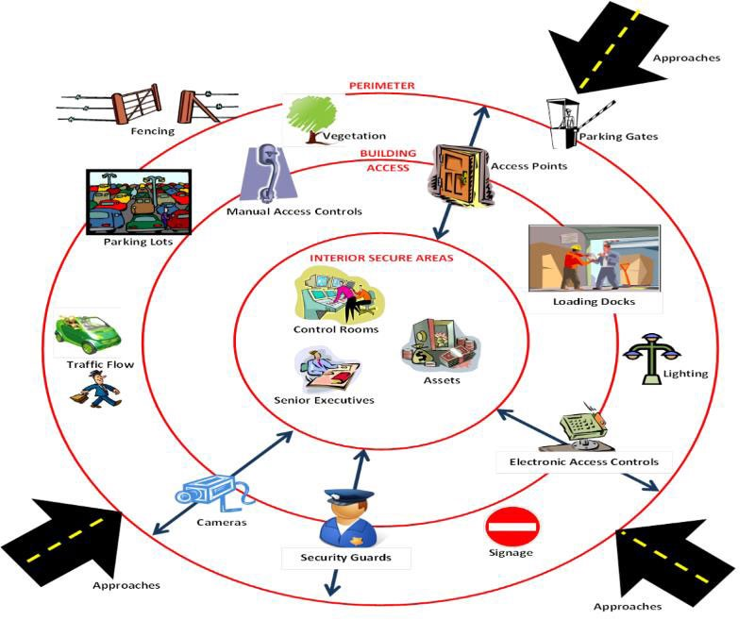
Analogy: Home and Office Security
Notes:
A physical analogy can help to understand a virtual system. Compare web application security with physically securing a home or office:
You need to know who wants access and decide what they should be able to access. (authentication, authorization)
You need to prevent unauthorized physical entry with multiple devices (locks, keys, safes, etc.)
You need to detect, log, monitor and alert about multiple types of problems, including entry and theft, but also the condition of the system (temperature, smoke, carbon dioxide, functioning sensors).
Multiple safeguards are more likely to deter various types of breaches and attacks than just locking the front door.
There are multiple layers and access points of security to defend (defense in depth, zero trust).
More sensitive areas and valuable assets require more protection.
How and how well you secure your home or office depends on valuables, budget, and risk tolerance.

Slide 5
University Data to Secure
Regulations
CSU IT Policy: http://policylibrary.colostate.edu/policy.aspx?id=492
FERPA: student records
HIPAA: medical records
GDPR, CCPA, CPA: individual privacy and security
PCI-DSS: credit cards
CORA: state higher ed institution records
Data
Levels: Public, Restricted, Private
User roles: faculty/staff, student, associate, general public
Types: academic, contact, HR, financial, health, etc.
Examples:
Name, address, phone, email (public for staff)
Usernames, passwords
Credit card details, account numbers
University ID number, SSN, driver’s license, DOB
Notes:
CSU systems are required to follow many laws and regulations to protect sensitive data.
The CSU IT policy is a good starting point for determining applicable regulations, data to protect, and security measures.
Not all data is created equal, and classifying your data helps you determine storage and protection policies for it.

Slide 6
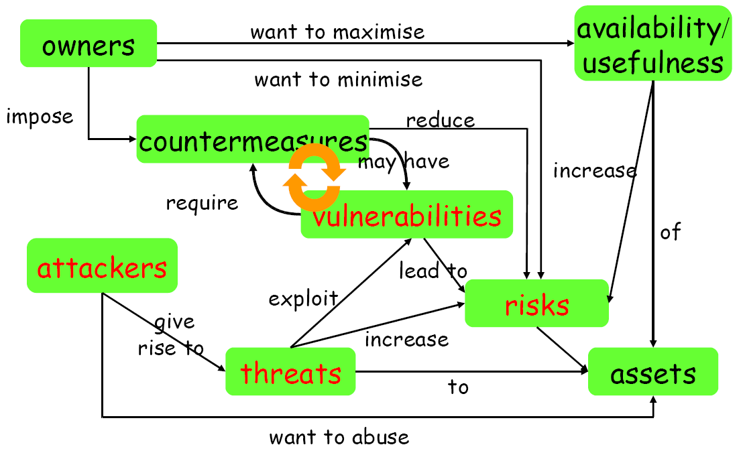
Security Concepts
Source: http://www.cs.ucf.edu/~czou/CAP6135-12/software-security-intro.ppt p. 10
Notes:
System owners want to maximize availability and usefulness of assets (data) in a system, but this increases risks.
Attackers use threats to exploit vulnerabilities (weaknesses) in order to abuse assets.
System owners must impose countermeasures (mitigations) to decrease vulnerabilities and reduce risks.

Slide 7
Web Application Ecosystem
Websites
Applications
in-house/vendor/open source
client/server/cloud
sites/apps/browser plugins
Application components, libraries, frameworks
Servers: application, database, file
Networks
People
Organizations

Slide 8
Securing the Components
Securing the Users
Devices
Awareness
Training
Source: https://docs.microsoft.com/en-us/previous-versions/msp-n-p/ff649874(v=pandp.10)
Notes:
Securing the application is the focus of this presentation, but only one part of the system that you may need to secure.
Note that security is often begun in the network and host boxes, but application security requires work listed in the red box (application layer).
The CSU NOC secures the network, and the CSU Infrastructure team secures the hosts and servers.
Kelly Poto helps secure the users through awareness training.

Slide 9
Securing the Components
Securing the application
Input validation | Session mgmt | Authentication
Authorization | Config mgmt | Error handling
Secure storage | Auditing/logging
Web server
App server
DB server
Firewall
Apps
Firewall
Apps
Database
Host
Host
Host
Securing the network
Router
Firewall
Switch
Securing the host
Patches/updates | Accounts | Ports
Services | Files/directories | Registry
Protocols | Shares | Auditing/logging
Source: https://owasp.org/www-pdf-archive/OWASP-SF-2014.pdf p. 25
Notes:
The original diagram?

Slide 10
OWASP Risks
Source: http://owasptop10.googlecode.com/files/OWASP%20Top%2010%20-%202013.pdf p. 5
Notes:
Threat agents use attack vectors to attack security weaknesses.
Security controls protect assets and functions against the weaknesses to minimize business impacts.

Slide 11
Attack Vectors
system
infrastructure
communication
language
architecture
component
information, any data
physical layer
logical layer
storage device / facility
(communication) channel
interface
encryption
environment
site (including DR)
transaction
log and audit trail
archive
process (operations, ongoing, development)
Source: https://www.owasp.org/images/0/0b/OWASPIL-2014-06-16_OWASP-Top-10_-_Security-Testing.pptx p. 13
Notes:
Attack vectors are parts of the system that must be secured.

Slide 12
Attack Types
Takeover
Data theft
Data tampering
System integrity disruption
Business Logic manipulation
Eavesdropping
Backdoors – built in by design
Backdoors – creation by attackers
Unintentional attacks
Intentional by authorized entities
Attacks by non-human entities
Denial of Service
De Facto Denial of Service
Authorization bypass
Access bypass
Smuggling, Splitting and evasion-type attacks
Source: https://www.owasp.org/images/0/0b/OWASPIL-2014-06-16_OWASP-Top-10_-_Security-Testing.pptx p. 14
Notes:
There are many ways to classify attacks. These are just a few types to be prepared for.

Slide 13
Common Web Application Attacks
Cross-site scripting (XSS)
SQL injection
Command injection
Cross-site request forgery (CSRF)
Denial of service (DoS, DDoS)
Parameter tampering
Directory traversal
Buffer overflows

Slide 14
Web Application Security Risks OWASP Top 10, 2021
Broken Access Control
Cryptographic Failures
Injection
Insecure Design
Security Misconfiguration
Vulnerable and Outdated Components
Identification and Authentication Failures
Software and Data Integrity Failures
Security Logging and Monitoring Failures
Server-Side Request Forgery (SSRF)
Source: https://owasp.org/Top10/
Notes:
The Open Web Application Security Project has a wealth of free information on web application security.
It has been updating its Top 10 list every few years based on the most frequently logged problems.
The latest list is less focused on specific attacks and more on general categories of security failures, weaknesses, and design and process issues.
The list should be considered a starting point before developing a more comprehensive security program.

Slide 15
Mobile App Security Risks OWASP Top 10, 2016
Improper Platform Usage
Insecure Data Storage
Insecure Communication
Insecure Authentication
Insufficient Cryptography
Insecure Authorization
Client Code Quality
Code Tampering
Reverse Engineering
Extraneous Functionality
Source: https://owasp.org/www-project-mobile-top-10/

Slide 16
Top 25 Most Dangerous Software Weaknesses
Out-of-bounds Write
Improper Neutralization of Input During Web Page Generation ('Cross-site Scripting')
Out-of-bounds Read
Improper Input Validation
Improper Neutralization of Special Elements used in an OS Command ('OS Command Injection')
Improper Neutralization of Special Elements used in an SQL Command ('SQL Injection')
Use After Free
Improper Limitation of a Pathname to a Restricted Directory ('Path Traversal')
Cross-Site Request Forgery (CSRF)
Unrestricted Upload of File with Dangerous Type
Missing Authentication for Critical Function
Integer Overflow or Wraparound
Deserialization of Untrusted Data
Improper Authentication
NULL Pointer Dereference
Use of Hard-coded Credentials
Improper Restriction of Operations within the Bounds of a Memory Buffer
Missing Authorization
Incorrect Default Permissions
Exposure of Sensitive Information to an Unauthorized Actor
Insufficiently Protected Credentials
Incorrect Permission Assignment for Critical Resource
Improper Restriction of XML External Entity Reference
Server-Side Request Forgery (SSRF)
Improper Neutralization of Special Elements used in a Command ('Command Injection')
Source: https://cwe.mitre.org/top25/archive/2021/2021_cwe_top25.html
Notes:
The Common Weakness Enumeration (CWE) list is a more specific list of attacks and weaknesses.
It is a very long list, and these are just the top 25.
Each of the OWASP Top 10 is linked to several CWEs. Broken Access Control is mapped to 34 CWEs.

Slide 17
Secure Design Principles
OWASP
10 Security by Design Principles
IEEE.org CyberSecurity Initiative
Avoiding the top 10 software security design flaws
Microsoft
Basic Security Practices for Web Applications
SANS
Securing Web Application Technologies (SWAT) Checklist

Slide 18
Security By Design Principles OWASP
Minimize attack surface area
Establish secure defaults
Principle of least privilege
Principle of defense in depth
Fail securely
Don’t trust services
Separation of duties
Avoid security by obscurity
Keep security simple
Fix security issues correctly
Source: https://wiki.owasp.org/index.php/Security_by_Design_Principles
Notes:
Different organizations and companies group security issues into general principles and practices.
They serve as checklists for a minimum standard of security.
Building in security when designing and developing the system saves time and improves security over trying to add it on just before (or after) release.

Slide 19
Avoiding software security design flaws IEEE
Earn or give, but never assume, trust
Use an authentication mechanism that cannot be bypassed or tampered with
Authorize after you authenticate
Strictly separate data and control instructions, and never process control instructions received from untrusted sources
Define an approach that ensures all data are explicitly validated
Use cryptography correctly
Identify sensitive data and how they should be handled
Always consider the users
Understand how integrating external components changes your attack surface
Be flexible when considering future changes to objects and actors
Source: https://ieeecs-media.computer.org/media/technical-activities/CYBSI/docs/Top-10-Flaws.pdf

Slide 20
Basic Security Practices for Web Applications Microsoft
General Web Application Security Recommendations
Run Applications with Least Privileges
Know Your Users
Guard Against Malicious User Input
Access Databases Securely
Create Safe Error Messages
Keep Secrets Safely
Use Cookies Securely
Guard Against Denial-of-Service Threats
Source: https://docs.microsoft.com/en-us/previous-versions/aspnet/zdh19h94(v=vs.100)

Slide 21
Securing Web Application Technologies (SWAT) Checklist SANS
Error Handling and Logging
Data Protection
Configuration and Operations
Authentication
Session Management
Input and Output Handling
Access Control
Source: https://www.sans.org/cloud-security/securing-web-application-technologies/

Slide 22
Mitigating Threats – CIA Pillars
Pillars | Threats | Actions
Confidentiality | information disclosure | access control, encryption, not storing secrets
Integrity | information tampering | access control, hashes, digital signatures
Availability | denial of service | graceful degradation, filtering, more resources
Source: http://www.cs.ucf.edu/~czou/CAP6135-12/software-security-intro.ppt p. 13, 33

Slide 23
Mitigating Threats - AAAA
AAA | Threats | Actions
Authentication | identity spoofing | protect keys and passwords
Authorization | unauthorized access, elevation of privilege | access control, sandboxing
Auditing | repudiation | logging, audit trails, digital signatures
Source: http://www.cs.ucf.edu/~czou/CAP6135-12/software-security-intro.ppt p. 15, 33

Slide 24
Risk Management Tasks
Category | Tasks
Planning and Management | Threat Modeling, Risk Analysis, Security Requirements
Prevention | Design Review, Code Review, Static Code Analysis tools, Penetration Testing, Dependency Management
Detection | Scanning, Monitoring, Auditing, Forensics
Reaction | Recovery, Mitigation
Source: http://www.cs.ucf.edu/~czou/CAP6135-12/software-security-intro.ppt p. 16, 33

Slide 25
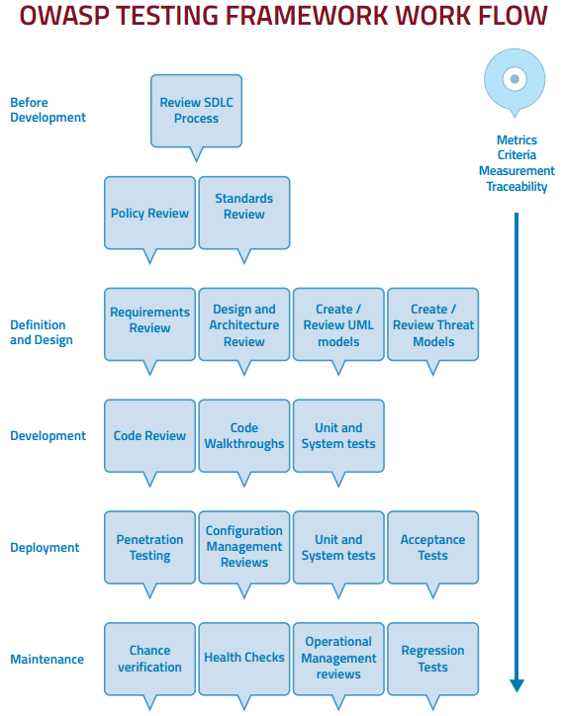
Source: https://owasp.org/www-project-web-security-testing-guide/assets/archive/OWASP_Testing_Guide_v4.pdf p. 28
Notes:
There are several software security models to help managers create a security plan for their unit.
The OWASP testing framework indicates tasks at each step in the software development lifecycle.

Slide 26
Software Assurance Maturity Model
Model details: https://owaspsamm.org/model/ Image source: https://owasp.org/www-event-2020-NewZealandDay/assets/presentations/Ellingsworth--OWASP_SAMM--20200221.pdf#page=11
Notes:
The software assurance maturity model is useful for larger groups with different roles. Each cell in the model has detailed recommendations.

Slide 27
Microsoft Security Development Lifecycle
Source: https://docs.microsoft.com/en-us/previous-versions/windows/desktop/cc307406(v=msdn.10)

Slide 28
Gary McGraw’s Seven Touchpoints
Source: http://www.swsec.com/resources/touchpoints/

Slide 29
Overview Part 2
General Concepts and Resources
Components, Attack Vectors and Types, Risks, Weaknesses
Secure Design Principles, Practices, and Software Lifecycle
CSU Tools, Techniques and Resources
Vulnerability Scans and Penetration Testing (Kelly Poto)
SSL Certificates with the InCommon Federation
Single Sign-On with Shibboleth
Two-Factor Authentication with Duo
Role-Based Authorization with Grouper Groups
ASP.NET Coding Examples – configuration, sanitizing I/O

Slide 30
Analysis and Testing Tools
Code Analysis
Usually language-specific; usually part of code review
Black Box testing
Vulnerability scan - general or vulnerability-specific analysis
Penetration test - simulate attack
Runtime test – end user analysis and test
Usually prior to deployment
E.g. OWASP ZAP, Burp Suite, Nessus
Resources:
https://owasp.org/www-project-web-security-testing-guide/stable/6-Appendix/A-Testing_Tools_Resource
https://owasp.org/www-community/Vulnerability_Scanning_Tools
https://owasp.org/www-community/controls/Static_Code_Analysis
https://owasp.org/www-community/Source_Code_Analysis_Tools
https://en.wikipedia.org/wiki/Security_testing
https://en.wikipedia.org/wiki/List_of_tools_for_static_code_analysis
https://en.wikipedia.org/wiki/Dynamic_application_security_testing
Notes:
There are many commercial and open-source analysis and testing tools.
CSU uses Burp Suite for scanning websites and Nessus for scanning other components in the system.

Slide 31
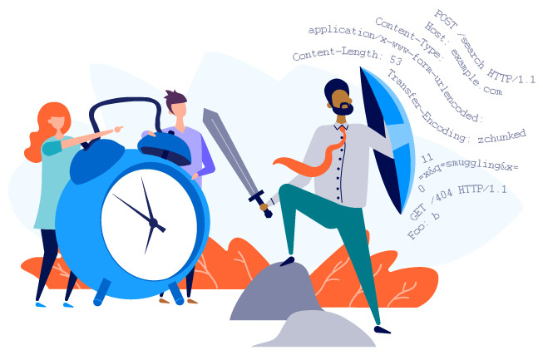
Cybersecurity and Privacy Web application scanning services
https://portswigger.net/burp/vulnerability-scanner

Slide 32
What is web application scanning?
Why would I want to scan my CSU E-commerce site?
https://owasp.org/www-project-top-ten/
Notes:
Just as the name suggestion, we are scanning a website application. All that is needed is the target URL .
Just as Zach as explained, you would want to have your site scanned to understand where there may be vulnerabilities. Many vulnerabilities are common and not always new, simple vulnerabilities are tried over and over, because we don’t fix them. Let’s take a quick look at this . According to OWASP, of the top 10 vulnerabilities documented in 2021, 6 of them were in the top 10 in 2017.

Slide 33
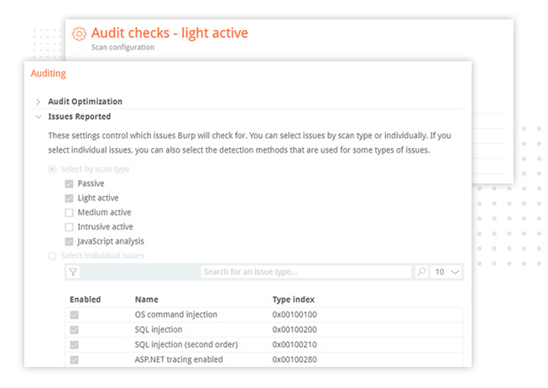
Penetration testing tool
How it works
Crawl site
Audit site
https://portswigger.net/burp/vulnerability-scanner
https://news.mit.edu/2012/spider-web-strength-0202
Notes:
Essentially, it’s a penetration testing tool. A target URL is provided, the site is crawled and then the site is audited, with credentials if required. The configurations are set up from minimally invasive scans to scans that will attempt to break your site. A detailed report is generated with scripts, mitigation strategies, and resources.

Slide 34
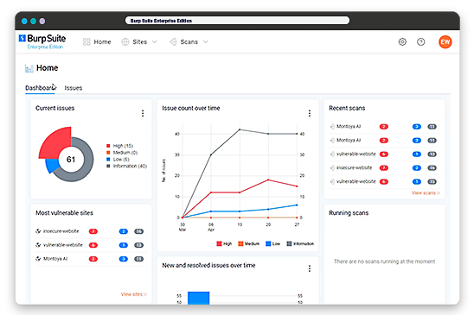
Reporting and Mitigation
https://portswigger.net/burp/vulnerability-scanner

Slide 35
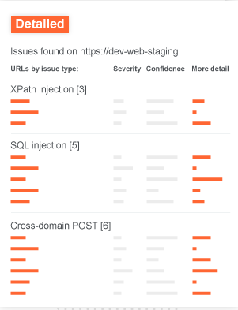
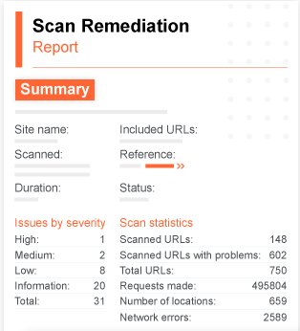
https://portswigger.net/burp/vulnerability-scanner

Slide 36
Web application scanning requests & FAQ’s
There is no charge to have a scan performed.
Scans can be performed any time or can be scheduled.
Scan can take anywhere from :01 to 24 hours.
Scan requests can be made through the Division of IT.

Slide 37
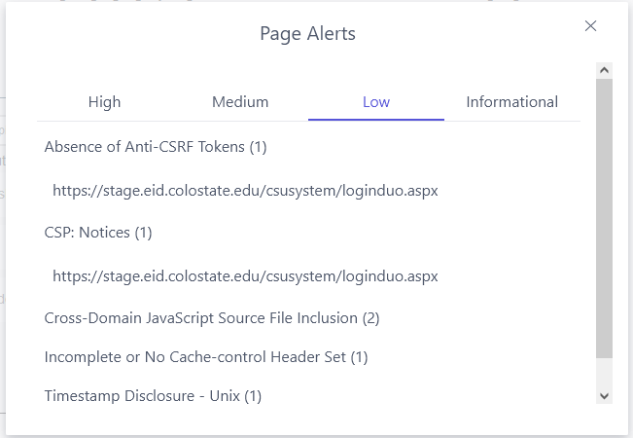
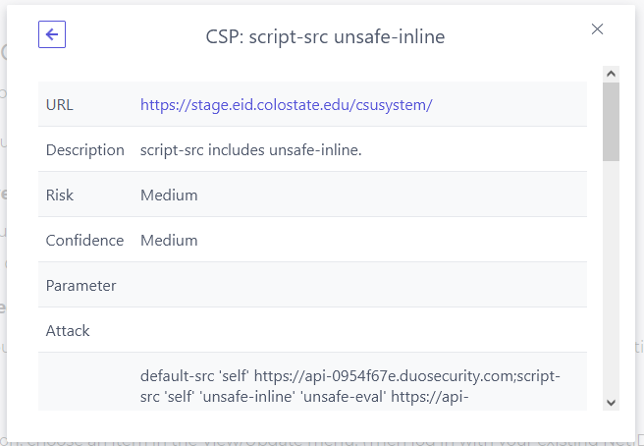
OWASP ZAP Toolbars and Alerts
Notes:
OWASP ZAP is a free, open-source tool that you can download and install on any computer.
It is not as comprehensive as the Burp Suite, but it is easy to use and a good starting point for detecting and learning about basic vulnerabilities.
It has a user interface that overlays on a web page in a browser to check a site and individual page for issues.
Page and site alerts have priorities from high to informational.
Clicking on an alert shows a URL, and clicking the URL shows details of the issue and links to details and mitigations.
Make sure to run in safe mode on a test or staging site so you don’t damage a production site.
Obtain permission for and schedule the scan with the site owner.

Slide 38
CSU IAM Architecture Diagram
Databases
Identity
Authorization
Authentication
Account Management
Web Apps
Banner
(HR, SIS)
WebAuth
Oracle
IS
eID Website
Grouper
Shibboleth
eID/NetID Web Apps
SQL Server
AppDev
MidPoint
OpenLDAP
Duo Mobile
NetID Website
Active Directory
Microsoft
Microsoft Web Apps
Postgres IAM
COmanage
Invitation Website
Social Login
External ID Web Apps
Notes:
The CSU identity and access management ecosystem has many components to secure, including:
Identity management systems: Banner, MidPoint and COmanage
Access management systems: Grouper, OpenLDAP and Active Directory
Provisioning systems: MidPoint, COmanage, Grouper
Authentication systems: WebAuth, Shibboleth, Duo Mobile, Microsoft and social login
Account management websites: eID, NetID and Invitation
Web applications: Locally and remotely hosted, developed by CSU and third-party vendors
This diagram is grouped by the role of each component.
Most end users only see and directly interact with the front-end components on the right.

Slide 39
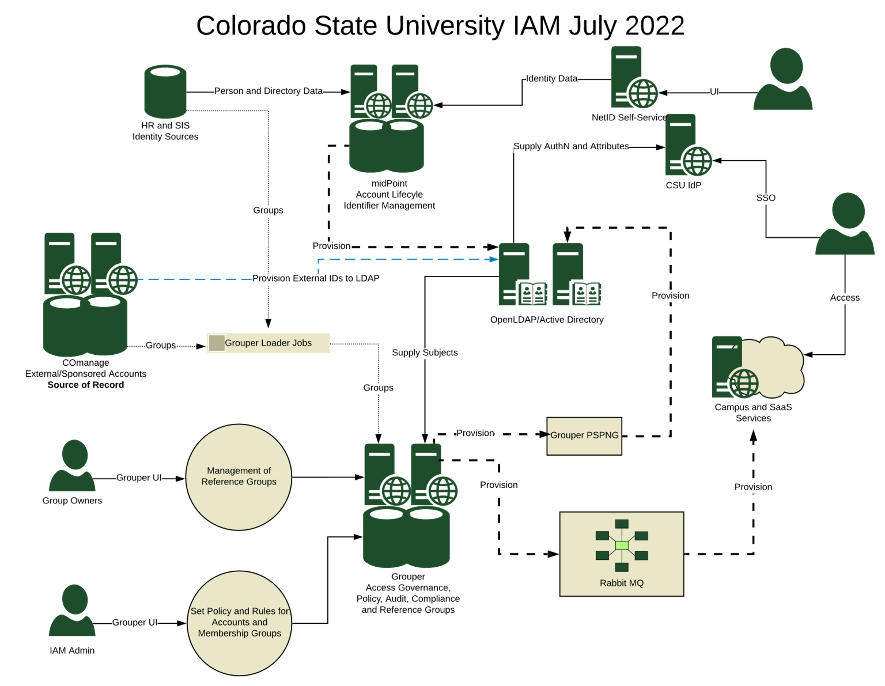
Notes:
This diagram shows the CSU IAM system when MidPoint has replaced eID.
It includes provisioning and the important role of Grouper in access management.

Slide 40
InCommon SSL Certificates
SSL encrypts HTTP traffic for privacy
URL starts with https:// and address shows padlock icon
Steps to set up SSL for a website
Review InCommon Certificates at CSU
Generate a Certificate Signing Request (CSR)
Complete CSU InCommon Certificate Request Form
CSU cert admins (RAOs) request a cert from Sectigo
Receive email from Sectigo with links to the cert
Install the certificate on your web server and test
Understand and check your endpoint encryption score
CSU SSL Cert Admins: certadmin@colostate.edu
Notes:
The InCommon Federation provides global single sign-on through Shibboleth, and SSL certificates for websites.
Its member organizations include CSU and many other education and research institutions.
Members enter information into a trust registry so they can securely collaborate and share resources using standard tools and practices.
CSU provides a service to generate SSL certificates through a third-party vendor (Sectigo) which are installed on web servers.

Slide 41
Password Management Options
Use single sign-on for CSU identities
CSU Federation – CSU and partner applications
Passwords are stored in eID or MidPoint, sent to LDAP and AD
InCommon Federation – other universities/organizations
Use social login for non-CSU identities
Google, Microsoft, Facebook, etc.
CSU uses the Social-SAML Gateway from Cirrus Identity
Apps: FAMweb, RamRecords, Advancement, BFS
Use your app only if options above are not feasible
Password capture, validation, encryption, storage
Difficult to secure well
Notes:
If your CSU web application needs password-based authentication, you have three options.
The first option is the most common and is recommended for most cases.

Slide 42
Password Storage Best Practices
Do not store passwords in plain text
Passwords should be hashed, not encrypted
One-way function, not reversible, can’t be decrypted
Hash algorithms: Argon2id, bcrypt, scrypt, PBKDF2
Use parameters correctly: salt, pepper, work factor
Use built-in libraries for your coding language, if any
For .NET framework, use PBKDF2: Rfc2898DerivedBytes
Resources
https://cheatsheetseries.owasp.org/cheatsheets/Password_Storage_Cheat_Sheet.html
https://tools.ietf.org/id/draft-whited-kitten-password-storage-02.html
https://www.mking.net/blog/password-security-best-practices-with-examples-in-csharp
Notes:
If your web application must store passwords, follow OWASP recommendations about password encryption and storage.

Slide 43
CSU Password Validation Rules
At least 15 characters in length
Numbers, upper-case letters, and special characters are NOT required, but allowed.
Not derived from a user’s name or login ID
Not derived from system-specific information
hostname, aliases or entries in users’ files
Easily memorized but not obvious to guess
Not single-word dictionary entry
Not phrase based on organizational affiliation or personal/professional interests
Change default vendor-supplied passwords before putting in production
Systems should protect against guessing attacks
Require annual password changes
Track failed login attempts
Lock user accounts for one hour after 14 consecutive failed logins
Source: http://policylibrary.colostate.edu/policy.aspx?id=492#sectionii
Notes:
The CSU IT policy has a section about CSU password format and protection requirements, as well as recommendations for end users.

Slide 44
CSU Single Sign-on with Shibboleth
If the application is hosted outside of colostate.edu:
Send us SP metadata, requested attributes, vendor docs
Ask vendor if they provide InCommon Research & Scholarship SP
We configure IdP, add SP metadata, release attributes
If the application uses a colostate.edu subdomain:
Install service provider on your app’s web server
See instructions for IIS or Ubuntu/Apache
Request access to CSU Federation Manager
Add metadata to CSU Federation Manager
Service Provider certificate and shibboleth2.xml metadata
Resources:
CSU Single Sign-on, Shibboleth, SAML2
CSU Federation - access requires campus IP or VPN
CSU Shibboleth admins: iamhelp@colostate.edu
Notes:
Identity Provider (IdP) – software on a central IT server to manage authentication and identities
Service Provider (SP) – software on an application server to send and receive requests to the identity provider
The CSU Federation website contains documentation about configuring your web application and service provider to use Shibboleth.
If you need help with setting up

Slide 45
CSU Two-Factor Authentication with Duo
A second factor greatly enhances security.
To force a Duo prompt for all users, either:
(preferred) Add to your service provider in shibboleth2.xml:
<SSO authnContextClassRef="http://colostate.edu/mfa" entityID="https://shibidp.colostate.edu/idp/shibboleth" forceAuthn="true">SAML2</SSO>
Ask the IdP administrators to configure your SP for Duo in IdP
Can display Duo prompt with JavaScript, in rare cases:
Allow unactivated Duo accounts to pass through
Multiple apps on same subdomain with different behaviors
Duo admins create Duo apps for web applications.
About Duo at CSU: https://duo.colostate.edu/

Slide 46
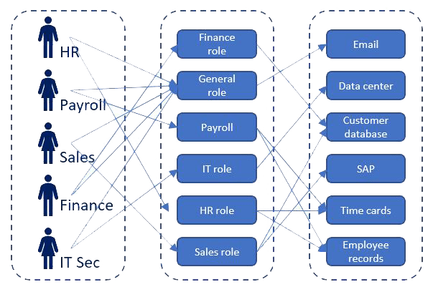
Role-Based Access Control
Roles
Unauthenticated/Authenticated
Authorization:
partial/full admin, specialist
Role scopes
Assets the group can manage
Permissions to do operations
Role groups
Members
Role assignments
Link role to role group
Groups
Roles
Assets

Slide 47
Role-Based Access Control Build it yourself (last resort only)
Store in database tables for:
Users
Groups
Members
Roles
Assignments
Privileges
Problems: Difficult to secure, does not scale well

Slide 48
Group Management with Grouper
Can add members from databases with loader jobs
or manually
Easy access management
automatic adds/removals when people join/leave
Use over 60,000 existing groups from CSU HR, SIS data
college, dept, course, major, etc.
Used by many applications at CSU
Adobe, ArcGIS, Bridge, CAS, Exchange, Kuali, Nelnet, Transfort
Resources:
Login: https://grouper.colostate.edu/
CSU Grouper Documentation (on campus or VPN)
CSU Grouper admins: iamhelp@colostate.edu

Slide 49
Authorization with Grouper
Grouper groups are created for applications
PSPNG jobs create entitlement attributes in LDAP
Shib login returns LDAP attributes as HTTP headers
Application checks HTTP headers for entitlements
Application assigns roles based on entitlements
Resource:
Simple .NET C# Shibboleth AuthN with AuthZ Example

Slide 50
Grouper Groups

Slide 51
Grouper Group Members

Slide 52
Grouper Attribute Assignments

Slide 53
LDAP eduPerson Entitlements

Slide 54
Application Gets HTTP Headers
protected Dictionary<string, string> GetHeaders()
{
var results = new Dictionary<string, string>();
var headers = HttpContext.Current.Request.Headers;
for (var i = 0; i < headers.Count; i++)
results[headers.GetKey(i)] = headers.Get(i);
return results;
}
protected string GetHeader(string header, Dictionary<string, string> headers) =>
headers.ContainsKey(header) ? headers[header] : Empty;

Slide 55
Application Gets Shibboleth Attributes
public ShibbolethAttributes(Dictionary<string, string> headers)
{
// identifiers
csuid = GetHeader("colostateEduPersonCSUID", headers);
email = GetHeader("mail", headers);
[…]
// names
firstName = GetHeader("givenName", headers);
[…]
// groups
entitlement = GetHeader("eduPersonEntitlement", headers);
}

Slide 56
Application Checks Entitlements
// CSU FC admins - validated using Grouper entitlement/eID
public static bool IsFullAdmin() => IsAdminInGrouper(FullAdminEntitlement);
public static bool IsReadOnlyEnameAdmin() => IsAdminInGrouper(ReadOnlyAdminEntitlement);
public static bool IsPartialEnameAdmin() => IsAdminInGrouper(PartialAdminEntitlement);
public static bool IsAdminInGrouper(string entitlement) =>GetShibbolethAttributes()?.entitlement != null && GetShibbolethAttributes().entitlement.Split(';').Contains(entitlement);
public static bool IsAdminInGrouper(ShibbolethAttributes shibbolethAttributes) =>
(shibbolethAttributes?.entitlement ?? Empty).Split(';').Intersect(AdminEntitlements).Any();

Slide 57
Protected Pages Check Roles
protected void Page_Load(object sender, EventArgs e)
{
[…]
RequireAnyAdmin();
[…]
}
protected void RequireAnyAdmin()
{
CheckSession(); // assure the user has authenticated
if (!IsAnyAdmin(CsuSystemDb))
Response.Redirect("~/error.aspx?message=unauthorized");
}

Slide 58
ASP.NET Code Examples
Security HTTP response headers: legacy, CSP
Prevent unauthorized access to sensitive info
Prevent injection: input validation
Prevent cross-site scripting: output encoding
Prevent cross-site request forgery
Protect data in transit: TLS 1.2
Resources:
Cheat sheets for many coding languages: https://cheatsheetseries.owasp.org/Glossary.html
https://cheatsheetseries.owasp.org/cheatsheets/DotNet_Security_Cheat_Sheet.html

Slide 59
ASP.NET: Web.config Security HTTP Response Headers
<system.webServer>
<httpProtocol>
<customHeaders>
<add name="X-Content-Type-Options" value="nosniff"/>
<add name="X-Xss-Protection" value="1; mode=block"/>
<add name="X-Frame-Options" value="DENY"/>
<add name="Strict-Transport-Security" value="max-age=31536000; includeSubDomains"/>
<add name="Referrer-Policy" value="strict-origin-when-cross-origin"/>
<add name="X-Permitted-Cross-Domain-Policies" value="master-only"/>
</customHeaders>
</httpProtocol>
</system.webServer>
Resources:
https://www.acns.colostate.edu/security/#tech-html-headers
CSU Secure Headers Chrome extension - checks for the 4 CSU-required headers and more
https://securityheaders.com/ - scan a site, graded A-F, improvement tips: Chrome, Firefox
https://wiki.owasp.org/index.php/OWASP_Secure_Headers_Project - docs, tools, best practices
https://developer.mozilla.org/en-US/docs/Web/HTTP/Headers
Notes:
Required by CSU:
X-Content-Type-Options nosniff prevents using a different MIME type than what the server has configured (e.g. text/css for styles, text/JavaScript for scripts).
X-Xss-Protection stops pages from loading when detecting XSS attacks. For modern browsers, also use a CSP without allowing ‘unsafe-inline’.
X-Frame-Options DENY prevents the site from being embedded into other sides for click-jack attacks. SAMEORIGIN allows framing content from the same domain. For modern browsers, also use a CSP with frame-ancestors.
Strict-Transport-Security tells browsers the site should only be accessed using https. max-age is the time to remember this setting. (31536000 seconds is one year.)
Also recommended:
Referrer-Policy no-referrer omits the Referer (sic) header. Chrome uses strict-origin-when-cross-origin if not set, which offers better privacy than the previous default no-referrer-when-downgrade, but still using referrer information in analytics.
X-Permitted-Cross-Domain-Policies – use master-only to only allow the master policy. Permits clients like Adobe Acrobat to handle data across domains.

Slide 60
ASP.NET: Web.config Content Security Policy Header
<system.webServer>
<httpProtocol>
<customHeaders>
<add name="Content-Security-Policy" value="
default-src 'self';
child-src 'self' https://www.google.com *.duosecurity.com;
connect-src 'self' https://www.google-analytics.com;
form-action 'self';
font-src 'self' https://maxcdn.bootstrapcdn.com https://static.colostate.edu
https://fonts.gstatic.com https://cdnjs.cloudflare.com;
frame-ancestors 'none';
img-src 'self' data: *.duosecurity.com https://www.gstatic.com https://www.google.com
https://www.google-analytics.com https://www.googletagmanager.com
https://cdn.datatables.net https://static.colostate.edu https://tracking.monsido.com;
script-src 'self' 'unsafe-inline' 'unsafe-eval' *.duosecurity.com https://www.google-
analytics.com https://www.googletagmanager.com https://www.google.com
https://www.gstatic.com https://cdn.datatables.net https://cdn.monsido.com;
style-src 'self' 'unsafe-inline' *.duosecurity.com https://maxcdn.bootstrapcdn.com
https://cdn.datatables.net https://fonts.googleapis.com https://static.colostate.edu
https://cdnjs.cloudflare.com;
"/>
</customHeaders>
</httpProtocol>
</system.webServer>
Source: https://cheatsheetseries.owasp.org/cheatsheets/Content_Security_Policy_Cheat_Sheet.html
Notes:
A Content Security Policy provides improved protection against many attacks, by specifying allow lists of third-party sources and destinations.
But it can be difficult to fully implement, especially on sites with lots of third-party sources such as WordPress plugins and analytics that require inline and evaluated JavaScript.
Img-src, script-src and style-src: sites that can load images, JavaScript and CSS into this site.
Child-src: sites that can load frames into this site.
Frame-ancestors: sites that can load this site into a frame.
Form-action: sites that can be posted to.
You can just report violations using Content-Security-Policy-Report-Only. Violations can be reported to a logging destination.
Avoid unsafe-inline and unsafe-eval if possible, since they remove important XSS and CSRF protections.
ASP.NET web forms generate lots of inline JavaScript and CSS on every web form, for which hashes would need to be manually added to the CSP.
I have not found an automated solution to generate a nonce and add to each inline style and script tag as well as the CSP.
https://cspscanner.com/ scans your site’s CSP and suggests ways to improve your letter grade.
https://report-uri.com/home/generate can import your CSP and help you generate a modified one.
https://rapidsec.com/csp-generator/ can crawl your site and create a CSP for you (commercial product).

Slide 61
ASP.NET: Web.config NWebSec Library
<nwebsec>
<httpHeaderSecurityModule xmlns="http://nwebsec.com/HttpHeaderSecurityModuleConfig.xsd" xmlns:xsi="http://www.w3.org/2001/XMLSchema-instance" xsi:noNamespaceSchemaLocation="NWebsecConfig/HttpHeaderSecurityModuleConfig.xsd">
<redirectValidation enabled="true">
<add allowedDestination="https://shibidp.colostate.edu"/> </redirectValidation>
<securityHttpHeaders>
<strict-Transport-Security max-age="365" includeSubdomains="true" />
<x-Content-Type-Options enabled="true" />
<x-Frame-Options policy="Deny"/>
<x-XSS-Protection policy="FilterEnabled" blockMode="true"/>
<content-Security-Policy enabled="true">
<default-src self="true"/>
<child-src self="true">
<add source="https://www.google.com" />
<add source="https://api-0954f67e.duosecurity.com" />
</child-src>
[…]
</content-Security-Policy>
</securityHttpHeaders>
</httpHeaderSecurityModule>
</nwebsec>
Source: https://docs.nwebsec.com/en/latest/
Notes:
The ASP.NET NWebSec library lets developers provide the content security policy and other security headers in a cleaner, easier to maintain XML format.
For MVC, the OWIN library can be used to generate nonces to prevent CSRF attacks.
Redirect validation prevents redirect attacks. Allowing a redirect to the CSU Identity Provider is necessary for login via Shibboleth.
Some headers are not available to NWebSec for web forms and must remain in customHeaders.

Slide 62
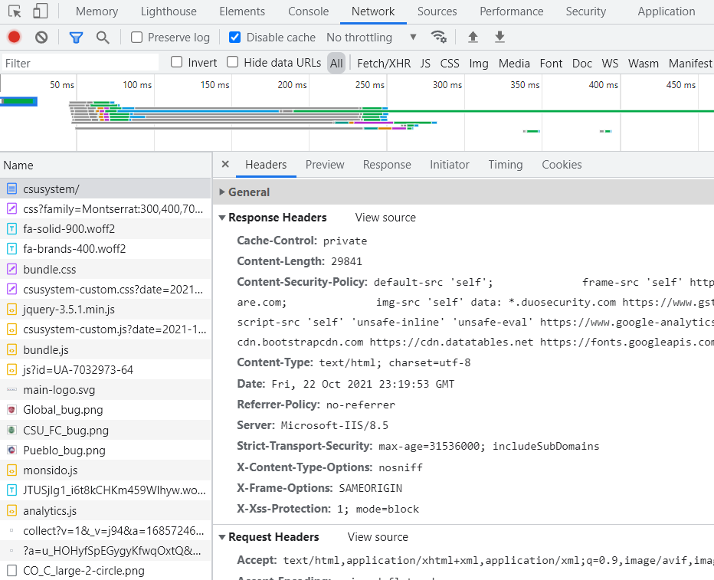
Browser Developer Tools Example: Google Chrome
Notes:
Use Developer Tools in browsers like Chrome and Firefox to check the response headers, including the content security policy, and to see that sensitive information is hidden.
In ASP.NET it is not easy to hide the Server.

Slide 63
Sensitive Information
Hide technical server details from HTTP requests
Hide technical debugging and error messages in production apps
Disable directory browsing
If not open-source, obfuscate your code so it can’t be decompiled
Sequential IDs can be browsed. Use random GUIDs.
https://colostate.instructure.com/accounts/1/users/1
https://colostate.instructure.com/accounts/1/users/3
…

Slide 64
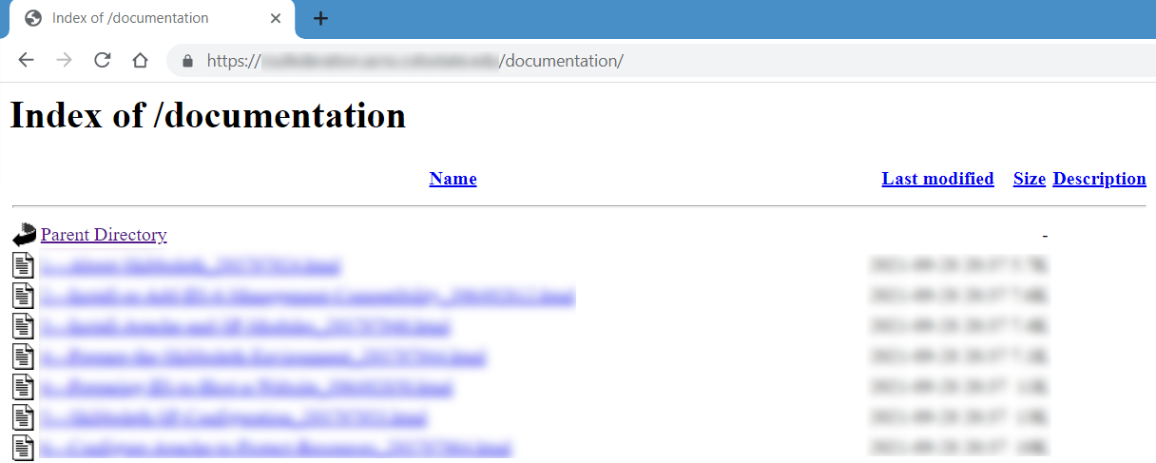
Disallow Directory Browsing
vi /etc/apache2/apache2.conf
<Directory /var/www/>
#Options Indexes FollowSymLinks
Options FollowSymLinks
</Directory>
service apache2 restart

Slide 65
ASP.NET: Web.config hide web server, disable trace and track
<system.webServer>
<httpProtocol>
<customHeaders>
<remove name="X-Powered-By"/>
</customHeaders>
</httpProtocol>
<security>
<requestFiltering>
<verbs>
<add verb="TRACE" allowed="false"/>
<add verb="TRACK" allowed="false"/>
</verbs>
</requestFiltering>
</security>
</system.webServer>

Slide 66
ASP.NET: Web.config hide errors, debugging; session timeout, require SSL
<system.web>
<customErrors mode="On" defaultRedirect="Error.aspx">
<error statusCode="404" redirect="Error.aspx?status=404"/>
[…]
</customErrors>
<compilation debug="false" targetFramework="4.7.2"></compilation>
<httpRuntime targetFramework="4.7.2" enableVersionHeader="false"/>
<sessionState timeout="15"/>
<httpCookies httpOnlyCookies="true" requireSSL="true"/>
</system.web>
Notes:
customErrors mode=“On” redirects to a custom error page.
compilation debug=“false” hides error messages and stack trace from the client.
enableVersionHeader=“false” hides the ASP.NET version.
sessionState timeout ends the session after a specified time. Shorter sessions are more secure, though they may require more frequent login.
httpOnlyCookies=“true” helps protect against XSS attacks.
requireSSL=“true” should be used for sites with SSL certificates.

Slide 67
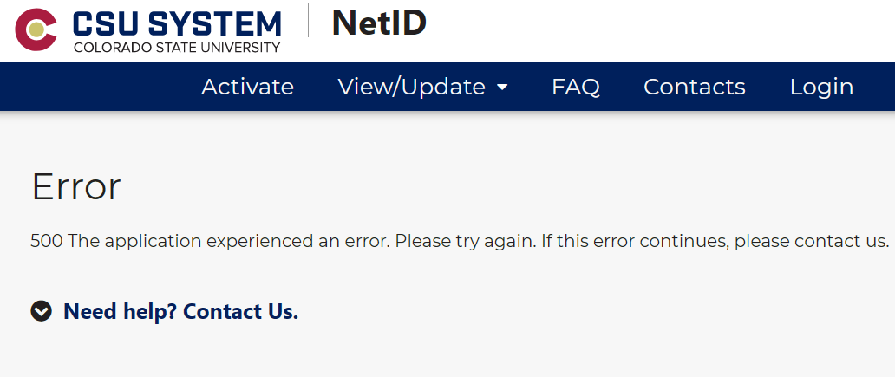
Custom Error Page
Hide technical details in logs
Example log entry: MidPoint API Error: ConnectionClosed The request was aborted: The connection was closed unexpectedly. API Call: POST users/[…]
Suggest user actions instead:

Slide 68
ASP.NET: Web.config
Keep sensitive configuration data in separate files
List them in .gitignore so they don’t check in to GitHub
Use software repository features to hide secrets
<appSettings file="PrivateSettings.config">
[…]
</appSettings>
<connectionStrings configSource="ConnectionStrings.config"/>

Slide 69
ASP.NET: Web.config test and restrict access to sensitive URLs: e.g. Elmah
Rewriter can send HTTP error codes using URL patterns
But IP-based access control is weak security
<rewriter>
<!-- restrict access to Elmah error logs -->
<if url="^/(.*)elmah.axd(.*)$">
<unless address="129.82.*">
<forbidden/>
</unless>
</if>
</rewriter>
<elmah>
<errorLog type="Elmah.SqlErrorLog, Elmah" connectionStringName="…" applicationName="…"/>
<security allowRemoteAccess="false"/>
</elmah>

Slide 70
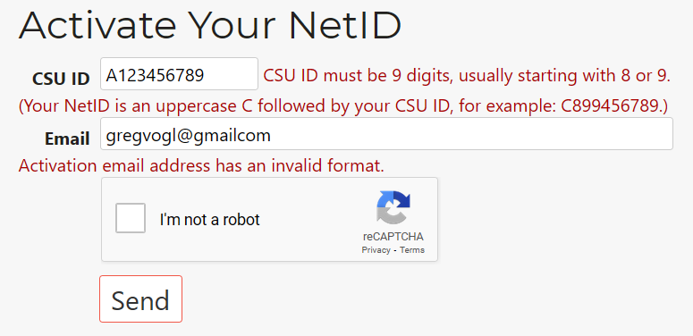
Input Validation
Use client side (JavaScript, HTML5) and server side validation
Validators: RequiredField, Range, RegularExpression, Custom
Required fields, length, range, format, type
Only allow characters in a specific list when possible
ReCAPTCHA to prevent automated entries
User-friendly labels, error messages, recovery help

Slide 71
ASP.NET Input Validation Code
<div> <!-- CSU ID -->
<asp:Label runat="server" Text="CSU ID" AssociatedControlID="txtCSUID" />
<asp:TextBox runat="server" ID="txtCSUID" Columns="12" MaxLength="10" ClientIDMode="Static" required />
<asp:RequiredFieldValidator runat="server" ID="rfvCSUID" Display="Dynamic" ControlToValidate="txtCSUID" ErrorMessage="CSU ID is required." />
<asp:RegularExpressionValidator runat="server" ID="revCSUID" Display="Dynamic" ControlToValidate="txtCSUID" EnableClientScript="True" ValidationExpression="^C?\d{9}$" ErrorMessage="CSU ID must be 9 digits, usually starting with 8 or 9. (Your NetID is an uppercase C followed by your CSU ID, for example: C899456789.)" />
</div>
Notes:
<div> <!-- Email -->
<asp:Label runat="server" AssociatedControlID="txtActivationEmail" Text="Email" />
<asp:TextBox runat="server" ID="txtActivationEmail" ClientIDMode="Static" Columns="55" MaxLength="50" type="email“ required />
<asp:RequiredFieldValidator runat="server" ID="rfvEmail" Display="Dynamic" ControlToValidate="txtActivationEmail" ErrorMessage="Activation Email address is required." />
<asp:RegularExpressionValidator runat="server" ID="revEmail" Display="Dynamic" ControlToValidate="txtActivationEmail" EnableClientScript="True" ValidationExpression="\w+([-+.']\w+)*@\w+([-.]\w+)*\.\w+([-.]\w+)*" ErrorMessage="Activation email address has an invalid format." />
</div>
<div class="g-recaptcha" data-sitekey="6LcZnQwUAAAAAH2K2yH9ME-s_lKyAIXMNxa6R4W_"></div>

Slide 72
Prevent Injection
Use positive server-side input validation
reject or sanitize bad input, e.g. <script>alert('test')</script>
Use ASP.NET request validation (enabled by default)
Prevents adding scripts to form inputs or URLs
Don’t concatenate strings to execute against database
Use an object relational mapper (ORM)
Build SQL statements with parameterized queries
Use stored procedures
Don’t display error output to the user
Use customErrors mode="on" or "remoteOnly"
Avoid unauthorized file access, e.g. ../../etc/passwd
Resources:
https://owasp.org/Top10/A03_2021-Injection/
https://cheatsheetseries.owasp.org/cheatsheets/Injection_Prevention_Cheat_Sheet.html
https://docs.microsoft.com/en-us/previous-versions/msp-n-p/ff647397(v=pandp.10)
Notes:
Avoid adding ValidateRequest="false" to Page tags

Slide 73
Prevent Cross-Site Scripting (XSS)
Validate input and encode output of unsafe (user-entered) data
HTML-encode
element characters < > become &lt; &gt; and attribute characters " ‘ become &quot; &apos;
user form input: Response.Write(HttpUtility.HtmlEncode(Request.Form["name"]));
Javascript-encode data in JavaScript
URL-encode characters in URL query strings
Response.Write(HttpUtility.UrlEncode(urlString));
Use AntiXssEncoder library in .NET 4.5+
Content Security Policy
Add third-party scripts to script-src and use nonce in script tag and CSP
Replace script-src ‘unsafe-inline’ and ‘unsafe-eval’ with ‘strict-dynamic’
Move all inline/in-page scripts to .js files or use hash in script tag and CSP
Resources:
https://owasp.org/www-community/attacks/xss/
https://cheatsheetseries.owasp.org/cheatsheets/Cross_Site_Scripting_Prevention_Cheat_Sheet.html
https://docs.microsoft.com/en-us/previous-versions/msp-n-p/ff649310(v=pandp.10)
https://docs.microsoft.com/en-us/dotnet/api/system.web.security.antixss.antixssencoder
Notes:
Cross-site scripting is a form of injection where a user’s input inserts a malicious script into a web application that is executed by a different user.
The script can rewrite the page, steal the victim user’s information from the browser,

Slide 74
Prevent Cross-Site Request Forgery
User is authenticated into an application
User clicks a malicious link in an email or website
Link executes unwanted actions with their privileges
Changes state (transfer funds, change email/password)
Protections
CSP, custom headers
cookie attribute SameSite=strict/lax, source origin/referrer
reauthentication, one-time-token, invisible CAPTCHA
// Prevent CSRF (add to a base page that other pages inherit)
protected override void OnInit(EventArgs e)
{
base.OnInit(e);
ViewStateUserKey =(string)(Session["SessionID"] = Session.SessionID)
}
Resources
https://cheatsheetseries.owasp.org/cheatsheets/Server_Side_Request_Forgery_Prevention_Cheat_Sheet.html
https://docs.microsoft.com/en-us/previous-versions/dotnet/articles/ms972969(v=msdn.10)
https://www.troyhunt.com/owasp-top-10-for-net-developers-part-5/
https://stackoverflow.com/questions/29939566/preventing-cross-site-request-forgery-csrf-attacks-in-asp-net-web-forms
Notes:
This solution causes intermittent errors on a load-balanced server when the app pool is restarted, even with a machineKey.
A double submit cookie (in the master page code behind) is another recommended solution.

Slide 75
Prevent Cross-Site Request Forgery Using System.Web.Helpers.AntiForgery
NuGet: install-package Microsoft.AspNet.WebPages
Also requires Razor
Add this to each .aspx form that can be submitted:
<%= System.Web.Helpers.AntiForgery.GetHtml() %>
Add this to OnLoad() method in Base Page:
if (IsPostBack)
System.Web.Helpers.AntiForgery.Validate();
Resources:
https://stackoverflow.com/questions/29939566/preventing-cross-site-request-forgery-csrf-attacks-in-asp-net-web-forms
Notes:
I tested that this works, and OWASP ZAP no longer complains about a missing token, but it requires a lot of extra code which is intended for ASP.NET MVC and Razor.

Slide 76
Prevent Server-Side Request Forgery
Web application fetches remote resource from URL
Attacker can supply malicious URL
Protections
Sanitize and validate all client-supplied input data
Enforce the URL schema, port, and destination
Use a positive allow list, not a deny list
Do not send raw responses to clients
Disable HTTP redirections
Be aware of the URL consistency
Resources:
https://owasp.org/Top10/A10_2021-Server-Side_Request_Forgery_%28SSRF%29/
https://cheatsheetseries.owasp.org/cheatsheets/Server_Side_Request_Forgery_Prevention_Cheat_Sheet.html

Slide 77
Prevent Click-Jacking
Frame makes user click on different target site
Overlay frame is transparent (CSS opacity: 0)
Protections:
old browsers: X-Frame-Options DENY or SAMEORIGIN
new browsers: CSP frame-ancestors ‘none’, ‘self’ or URLs
Resources:
https://cheatsheetseries.owasp.org/cheatsheets/Clickjacking_Defense_Cheat_Sheet.html
https://owasp.org/www-project-web-security-testing-guide/v41/4-Web_Application_Security_Testing/11-Client_Side_Testing/09-Testing_for_Clickjacking

Slide 78
Protect Data in Transit with TLS 1.2
Use TLS 1.2 for entire site and test
Can hard-code ASP.NET to use TLS 1.2 (e.g. in page load)
ServicePointManager.SecurityProtocol = SecurityProtocolType.Tls12;
But best to let the OS decide
Latest version is TLS 1.3 – faster, improved security
.NET Framework 4.7+ uses default security protocol in the OS
Resources:
https://cheatsheetseries.owasp.org/cheatsheets/Transport_Layer_Protection_Cheat_Sheet.html
https://docs.microsoft.com/en-us/dotnet/framework/network-programming/tls
https://www.ssllabs.com/ssltest/

Slide 79
Logging, Monitoring, Alerting
Log logins, login failures, high-value transactions
Log important warnings and errors with clear and sufficiently detailed messages
Store logs long enough to allow analysis
Monitoring and alerting to allow quick response
Store logs securely in multiple places
Use logging frameworks with custom dashboards and alerting
Resources:
https://owasp.org/Top10/A09_2021-Security_Logging_and_Monitoring_Failures/
https://cheatsheetseries.owasp.org/cheatsheets/Logging_Cheat_Sheet.html

Slide 80
Third-Party Code
Software, Frameworks, Plugins, Libraries
DLLs, JavaScript, latest .NET version supported by server
Use most recent versions
Keep inventory
Apply patches/updates ASAP
Use NuGet Package Manager in Visual Studio
Monitor reported vulnerabilities
Remove unused components, features, files
Resources:
https://owasp.org/Top10/A06_2021-Vulnerable_and_Outdated_Components/
https://www.nuget.org/

Slide 81
Selected Resources
People – IT Division – Cybersecurity & Privacy Dept.
Books – CSU Library, Prospector
Blogs – Sophos, Krebs, SANS
Organizations – OWASP Denver, Boulder
Conferences – OWASP Events, RMISC
Global AppSec US 2021 - YouTube videos, descriptions
Training – OWASP, SANS, PortSwigger, Udemy
Courses – CSU, CSU Online, CSU Global

Slide 82
Parting Recommendations
Learn, use, keep up with and share resources
concepts, techniques, checklists, tools, people, etc.
Develop your program, plans and strategies
Inventory and assess your WAS environment and risks
Add WAS to your Information Security Strategic Plan
Add WAS to your entire software lifecycle
Add WAS to your budget, job duties and metrics
Share ideas and successes with other IT groups at CSU

Slide 83
Questions
Comments
Suggestions
PDI Survey

